Slide 1
An Introduction to Elder Abuse for Pharmacists
Created by: the University of Southern California, School of Pharmacy and the Center of Excellence on Elder Abuse and Neglect, University of California, Irvine
Reaching Important Gatekeepers: Training Pharmacists about Elder Abuse
Notes:
Note to Instructor: These few slides provide a quick overview of aging demographics in the U.S., and a basic background about elder abuse and neglect. This Power Point presentation is appropriate for first-year pharmacy students.
This training module was created by the Center of Excellence on Elder Abuse & Neglect at University of California, Irvine and University of Southern California, School of Pharmacy. This project was funded by grants from Kaiser Permanente Southern California Region Community Benefit and UniHealth Foundation.
Visit www.centeronelderabuse.org/Kaiser_Pharmacy.asp to download a copy

Slide 2
Questions
1. Which population group is the fastest growing in the U.S.? A. Children B. Teens C. Elders D. Women
2. Elder abuse most commonly occurs in nursing home and residential care facilities? True or False
3. Pharmacists do not need to report elder abuse unless they are sure that abuse has occurred. True or False
4. Suspected elder abuse in the community should be reported to ___________.
5. The three types of medication abuse are:
______________ ______________ and __________
Notes:
You can choose the best way for you to use the pre-test questions. Repeat these questions at the end to measure student learning. Answers are provided in the Instructor Manual.

Slide 3
Questions continued
6. Which of these is NOT an example of possible elder abuse?
A. Although patient complains of pain, the caregiver rarely provides pain meds (prescribed PRN) to patient
B. Family member responsible for providing care leaves bedbound person unattended all day
C. Psychotropic drugs prescribed for Patient B are administered to Patient A to make her more agreeable
D. Adult child refuses to have a baby in order to provide parents with the grandchild that they deserve

Slide 4
Why Talk about Pharmacists and Elder Abuse?
Use of medication is the most common form of treatment in older people
Medications are often potent substances, which may have low therapeutic to toxic dose ratio
Seniors trust their pharmacists
Pharmacists are in a position to see signs of elder abuse
Notes:
Older adults use more medicines than other age groups, and are at increased risk of serious adverse drug events
for a number of reasons (e.g., age-related physiological changes, use of multiple medicines, drug interactions,
inappropriate prescribing and monitoring of drug therapy).
In addition, most older adults live with at least one chronic condition, take multiple medicines, have more than
one prescribing healthcare provider and use at least one pharmacy. (Source: MUST for Seniors™, www.mustforseniors.org NCPIE 2007. National Council on Patient Information and Education – NCPIE)
Pharmacists will have many elderly patients. And, they are trusted by those patients. Pharmacists are in a unique position to see signs of possible abuse of medications whether done by the senior him or herself or by a possible abuser.
Knowing the signs of elder/dependent adult abuse and knowing how to report suspected abuse are important skills for all pharmacists.

Slide 5
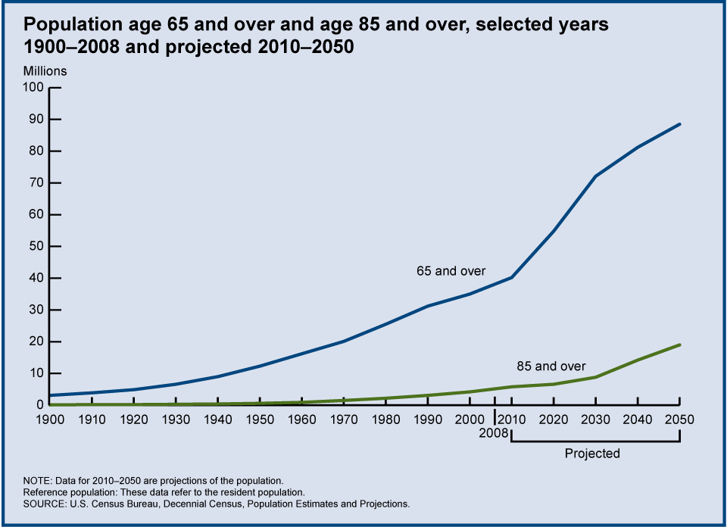
Aging Demographics in U.S.
Charts/graphs (global and US)
Notes:
Number of Older Americans
Older Americans 2010: Key Indicators of Well-Being (AgingStats.gov)
Older adults are the fastest growing population in the U.S.
The 65 and over population will increase to 80 -90 million by 2050, and the 85 and older population is projected to increase to close to 21 million.
As you can see, there’s a bulge in the 2010 population of people in their mid-forties to mid-sixties. In the U.S., the 79 million Baby Boomers (born in 1946 thru 1964) are just becoming seniors. As a result, over the next few decades the U.S. population will show an unprecedented growth in the oldest groups. By 2030, one in five Americans will be 65 or older.

Slide 6
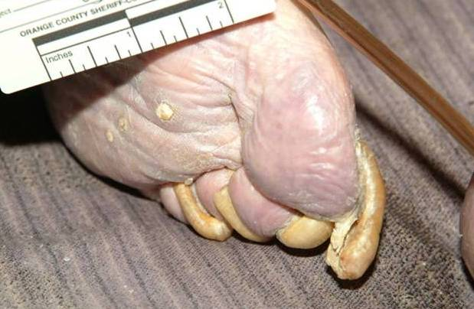
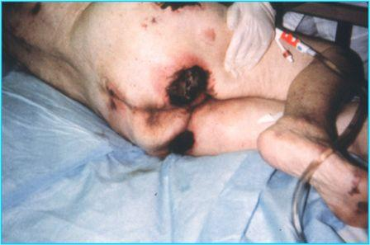
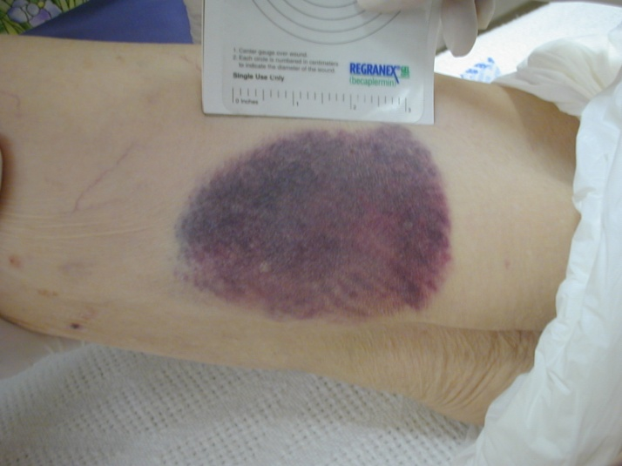
What is “elder abuse”?
Notes:
These pictures are graphic reminders of the impact that elder abuse can have:
Bedsores (pressure sore, decubitus ulcers)
Bruises
Overgrown nails
These are possible signs of neglect or physical abuse. Emotional, sexual and financial abuse don’t have such graphic signs, but often accompany physical abuse and neglect.

Slide 7
Elder Abuse is…
“Any knowing, intentional, or negligent act by a caregiver or any other person that causes harm or a serious risk of harm to a vulnerable adult.”
National Center on Elder Abuse
Notes:
For more information on the National Center on Elder Abuse, you can visit www.ncea.aoa.gov/

Slide 8
Who is covered by elder abuse laws?
In California,
Those 65 years of age and older
Those 18-64 years of age who have a disability
Anyone who is a patient in a hospital
Different states have different qualifying ages and other criteria. Learn your state’s laws.
Notes:
It is important to remember that though we are using the term “elder” abuse throughout this talk, there is another large population of people who are also covered under the “elder” abuse laws in California and many other states. These are adults with disabilities. The same reporting requirements exists for suspected abuse of an adult with a disability as exist for suspected elder abuse.

Slide 9
Types of Abuse
Physical Abuse
Financial Abuse
Neglect
Emotional Abuse
Sexual Abuse
Self-Neglect
Notes:
There are 6 primary types of reportable abuse, though many states add other specific types. For example, in California, isolation, abandonment, and abduction are also specified in the law.
.

Slide 10
Quick Quiz Question
Which is the setting where elder abuse most commonly occurs?
Adult Day Care Center
Nursing Home
Home in the Community
Hospital
Notes:
Instructor: ask the class to write down their answer to this question on a piece of paper. After a few moments, go through the questions with the learners and ask those who selected (a) Adult Day Care Centers to raise their hands. Go down the list of options. After you have completed the list, use the information below to inform them that the correct answer is (c) Home in the Community.
Which is the setting where elder abuse most commonly occurs?
Adult Day Care Center – Although participants of Adult Day Services and Adult Day Health Program are likely to be vulnerable, this is not the most common setting.
Nursing Home – if you hear about abuse in the news, most often it’s in nursing homes. But there’s so much more oversight over nursing home residents compared with community-dwelling adults. California Long-Term Care Ombudsmen received about 46,000 complaints in 2006, and typically about 10% of the complaints deal with abuse or neglect.
Home in the Community—this is the most common setting. The vast majority of elders are community-dwelling, but there are few protective measures in place to watch out for them. This is why the role of mandated reporters is so important.
Hospital—Any adult admitted to a 24-hour health facility is under “elder abuse protections” but this is not the most common setting

Slide 11
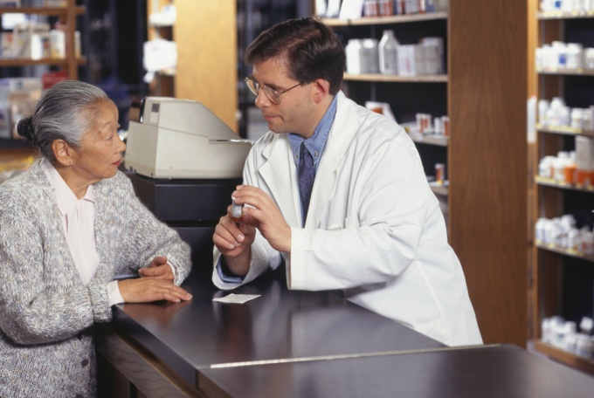
Elder Abuse Incidence
FOR EVERY REPORT OF ABUSE….
5 GO UNREPORTED
National Elder Abuse Incidence Study, 1998
Notes:
This finding is very important in understanding just how large the problem of elder abuse is. There are likely many victims of abuse being seen in pharmacies without having it recognized.

Slide 12
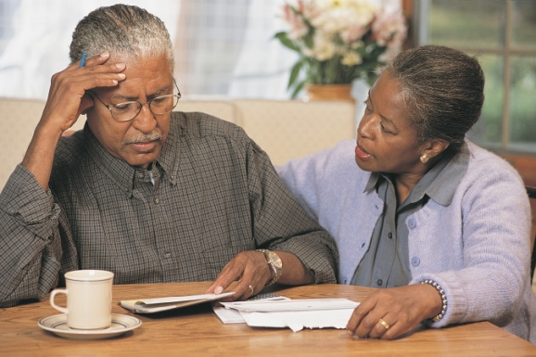
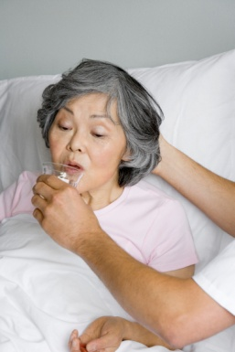
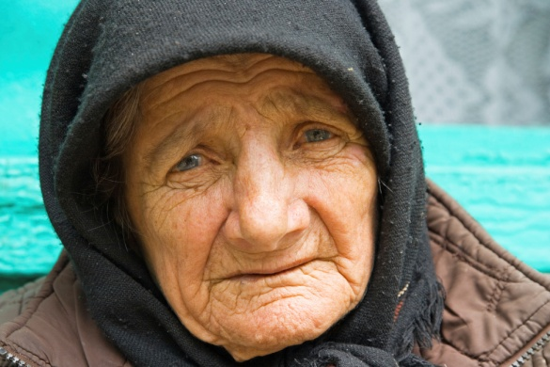
Reports on the Rise
In 2006 California APS agencies received over 104,000 reports of abuse and neglect, a 34 percent increase since 2000.
Notes:
In 2006, Adult Protective Services agencies in California received over 104,000 reports of elder abuse and neglect, up 34% from reports received in 2000. (Note that reports of elder mistreatment in long-term care facilities are not included.) Source: California Welfare Directors Association

Slide 13
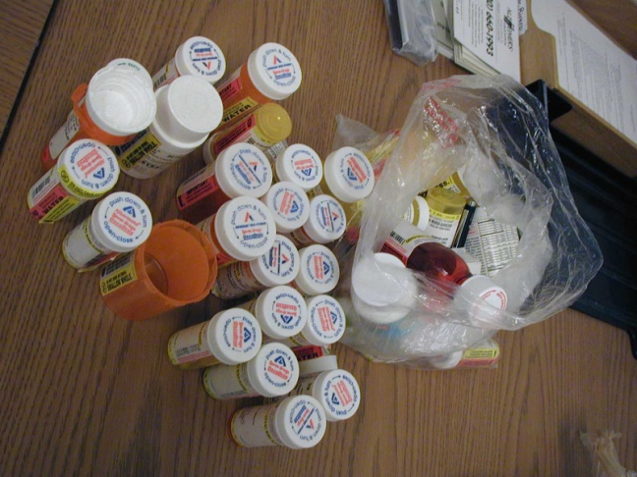
Medication Abuse
Medication abuse occurs when medication is overused, underused or misused, resulting in harm to an older person
The medication may or may not have been prescribed for the older person
The abuse occurs within a relationship of implied trust

Slide 14
Overuse and Underuse
Medication overuse occurs where medication is used for the correct indication but is given in higher doses than indicated
Medication underuse occurs where medication is used for the correct indication but is given in lower doses than indicated, or is withheld

Slide 15
Medication Abuse
Medication misuse occurs where:
incorrect medication is given
medication is given for the wrong reason or is used for a different purpose to its indication

Slide 16
From Request for Renewal of California Pharmacist License
Under California law each person licensed by the Board of Pharmacy is a “mandated reporter” for both child and elder abuse or neglect purposes.
What does this mean?
Notes:
Pharmacists are mandated reporters for both child and elder abuse or neglect purposes. That means if you observe, know of or reasonably suspect abuse or neglect, you must contact a reporting agency and let them know.

Slide 17
You must report elder abuse
California Penal Code section 11166 and Welfare and Institutions Code section 15630 require that all mandated reporters make a report to an agency [generally law enforcement, state, and/or county adult protective services agencies, etc… ] whenever the mandated reporter, in his or her professional capacity or within the scope of his or her employment, has knowledge of or observes a child, elder and/or dependent adult whom the mandated reporter knows or reasonably suspects has been the victim of child abuse or elder abuse or neglect.
Notes:
Pharmacists are mandated reporters for both child and elder abuse or neglect purposes. That means if you observe, know of or reasonably suspect abuse or neglect, you must contact a reporting agency and let them know.

Slide 18
How to Report Abuse
In the community:
Adult Protective Services
Social workers/nurses
Receive reports of abuse from mandated reporters and others
Work with elder/dependent adult to help them access resources in community to stay safe
In many states: Cross report to police
In residential facilities:
Long-term Care Ombudsman
Social workers/volunteers
Receive complaints from residents
Advocate on behalf of residents
Work with State Licensing to identify problems in facilities

Slide 19
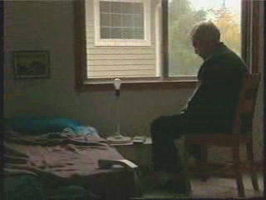
Public Service Announcement
Elder Abuse: The One Abuse Nobody Sees
It’s everyone’s business!
Notes:
{Instructor:
Choose one of the 30-secong Public Service Announcements available online to add a mini-video component to your presentation. Before your presentation, download the video from one of the websites.
Ontario Network for the Prevention of Elder Abuse raises the issues of Financial Abuse, Verbal Abuse, and Physical Abuse.
http://www.onpea.org/english/trainingtools/videos.html#
Texas Department of Family and Protective Services (DFPS) Adult Protective Services (APS) depicts the contrast between a man’s strength in young adulthood and his vulnerability in old age.
http://www.dfps.state.tx.us/everyonesbusiness/Overview.asp
Show the video and invite the class to comment on it. Did the video convey a strong message?}

Slide 20
Post-test questions
1. Which population group is the fastest growing in the U.S.? A. Children B. Teens C. Elders D. Women
2. Elder abuse most commonly occurs in nursing home and residential care facilities? True or False
3. Pharmacists do not need to report elder abuse unless they are sure that abuse has occurred. True or False
4. Suspected elder abuse in the community should be reported to ___________.
5. The three types of medication abuse are:
______________ ______________ and __________
Notes:
You can choose the best way for you to use the Post-test questions. Answers are provided in the Instructor Manual.

Slide 21
Post-test questions continued
6. Which of these is NOT an example of possible elder abuse?
A. Although patient complains of pain, the caregiver rarely provides pain meds (prescribed PRN) to patient
B. Family member responsible for providing care leaves bedbound person unattended all day
C. Psychotropic drugs prescribed for Patient B are administered to Patient A to make her more agreeable
D. Adult child refuses to have a baby in order to provide parents with the grandchild that they deserve

