Slide 1

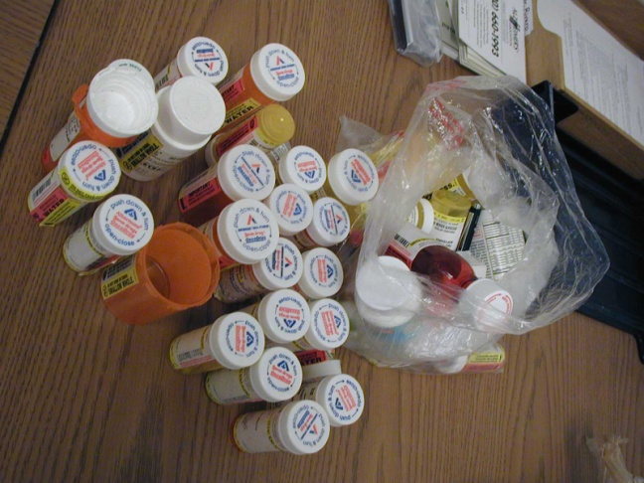

Elder Abuse:
The Pharmacist’s Role
Reaching Important Gatekeepers: Training Pharmacists about Elder Abuse
Notes:
Note to Instructor:
This slide-based lecture was designed for a one-hour workshop for third-year pharmacy students. This presentation could also be used to train community pharmacists.
Visit www.centeronelderabuse.org/Kaiser_Pharmacy.asp to download a copy
This training module was created by the Center of Excellence on Elder Abuse & Neglect at University of California, Irvine and University of Southern California, School of Pharmacy. The project was funded by grants from Kaiser Permanente Southern California Region Community Benefit and UniHealth Foundation.

Slide 2
Acknowledgements
Content by Tatanya Gurvich, Pharm.D. and Bradley Williams, Pharm. D., USC School of Pharmacy and Elaine Chen, MS and Mary Twomey, MSW, University of California, Irvine.
This training module was created by the Center of Excellence on Elder Abuse & Neglect at University of California, Irvine and University of Southern California, School of Pharmacy.
This project was funded by grants from Kaiser Permanente Southern California Region Community Benefit and UniHealth Foundation.
Special thanks to Leslie Vitin, Pharm.D. for contributions to this presentation

Slide 3

Objectives
Understand the etiology of elder abuse to increase awareness
Distinguish between the categories of abuse
Identify signs and symptoms of elder abuse as a health professional and mandatory reporter
Review the steps of reporting when abuse is suspected
Notes:
In the course of this workshop, you will:
Understand the etiology of Elder Abuse to increase awareness
Distinguish between the categories of Abuse
Identify signs and symptoms of Elder Abuse as a health professional and mandatory reporter
Review the steps of reporting when abuse is suspected

Slide 4
Why Talk about Pharmacists and Elder Abuse?
Use of medication is the most common form of treatment in older people
Medications are often potent substances, which may have low therapeutic to toxic dose ratio
Seniors trust their pharmacists
Pharmacists are in a position to see signs of elder abuse
Notes:
Older adults use more medicines than other age groups, and are at increased risk of serious adverse drug events
for a number of reasons (e.g., age-related physiological changes, use of multiple medicines, drug interactions,
inappropriate prescribing and monitoring of drug therapy).
In addition, most older adults live with at least one chronic condition, take multiple medicines, have more than
one prescribing healthcare provider and use at least one pharmacy. (Source: MUST for Seniors™, www.mustforseniors.org NCPIE 2007. National Council on Patient Information and Education – NCPIE)
Pharmacists will have many elderly patients. And, they are trusted by those patients. Pharmacists are in a unique position to see signs of possible abuse of medications whether done by the senior him or herself or by a possible abuser.
Knowing the signs of elder/dependent adult abuse and knowing how to report suspected abuse are important skills for all pharmacists.

Slide 5
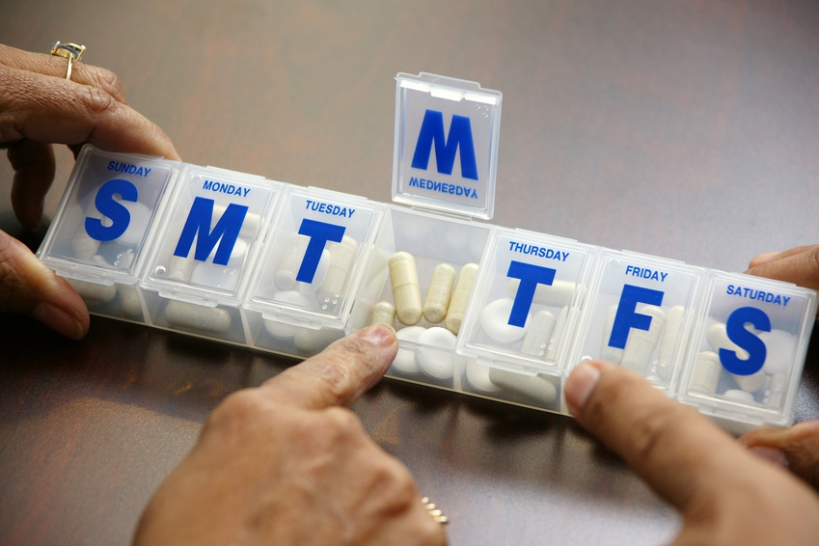
Where do Pharmacists Fit in?
Mandated Reporters: Health Care providers
  Any setting/scope of practice:
  Clinical Pharmacists in ANY setting
  Community Dispensing Pharmacists
  Pharmacists Consultants
Notes:
Pharmacists are mandated reporters, in any setting on scope of practice.
This includes clinical pharmacists, community dispensing pharmacists, and pharmacist consultants.
We’ll talk about how to make a report a little later.

Slide 6
Mandated Reporters
Full or intermittent responsibility of care or custody of an elder or dependent adult with or without compensation
  Health practitioners, clergy members, care custodians, employees of county adult protective services agencies, local law enforcement agencies, and employees of financial institutions
Notes:
Who is a mandated reporter?
Anyone with full or intermittent responsibility of care or custody of an elder or dependent adult with or without compensation
This includes:
Health practitioners, clergy members, care custodians, employees of county adult protective services agencies, local law enforcement agencies, and employees of financial institutions
Anyone can make a voluntary (non-mandatory) report as well.

Slide 7
From Request for Renewal of California Pharmacist License
Under California law each person licensed by the Board of Pharmacy is a “mandated reporter” for both child and elder abuse or neglect purposes.
Notes:
Pharmacists are mandated reporters for both child and elder abuse or neglect purposes. That means if you observe, know of or reasonably suspect abuse or neglect, you must contact a reporting agency and let them know.

Slide 8
You must report elder abuse
California Penal Code section 11166 and Welfare and Institutions Code section 15630 require that all mandated reporters make a report to an agency [generally law enforcement, state, and/or county adult protective services agencies, etc… ] whenever the mandated reporter, in his or her professional capacity or within the scope of his or her employment, has knowledge of or observes a child, elder and/or dependent adult whom the mandated reporter knows or reasonably suspects has been the victim of child abuse or elder abuse or neglect.
Notes:
Pharmacists are mandated reporters for both child and elder abuse or neglect purposes. That means if you observe, know of or reasonably suspect abuse or neglect, you must contact a reporting agency and let them know.

Slide 9
Medication Abuse
Medication abuse occurs when medication is overused, underused or misused, resulting in harm to an older person
The medication may or may not have been prescribed for the older person
The abuse occurs within a relationship of implied trust

Slide 10
Overuse and Underuse
Medication overuse occurs where medication is used for the correct indication but is given in higher doses than indicated
Medication underuse occurs where medication is used for the correct indication but is given in lower doses than indicated, or is withheld

Slide 11
Medication Abuse
Medication misuse occurs where:
incorrect medication is given
medication is given for the wrong reason or is used for a different purpose to its indication

Slide 12
An “Elder” is…
● Varies from state to state but generally is someone 65 years and older;
ALSO, don’t forget:
● “Dependent adult” is 18-64 years AND
“who has physical or mental limitations that restrict his or her ability to carry out normal activities or to protect his or her rights, including, but not limited to, persons who have physical or developmental disabilities, or whose physical or mental abilities have diminished because of age.”

Slide 13
Types of Abuse
Physical Abuse
Financial Abuse
Emotional Abuse
Sexual Abuse
Neglect
Self-Neglect
Notes:
Content - There are 7 types of reportable abuse in California
Note new additions based on new law SB 2199 - Self-Neglect, Abandonment, Abduction.
The 8th type of abuse, emotional/psychological abuse, is clinically recognized but not mandatory to report. Of course, it can still be reported even though it’s not covered by the mandated reporting laws.

Slide 14
How common is elder abuse?
It’s a good question, but a hard one to answer.

Slide 15
Why is it hard to answer?
Reluctance to admit
  Shame
  Fear of losing independence
  Fear of being moved
Unlike kids, older adults can quietly disappear from society without much inquiry
May be too incapacitated to report
Signs of abuse may be missed/mistaken for “usual aging”

Slide 16
FOR EVERY REPORT OF ABUSE….
At least 5 GO UNREPORTED
Notes:
This finding is very important in understanding just how large the problem of elder abuse is. There are likely many victims of abuse being seen in clinics and ER’s without having it recognized.
The National Elder Abuse Incidence Study , 1998, The National Center on Elder Abuse at The American Public Human Services Association* in Collaboration with Westat, Inc.

Slide 17
Best available estimates on prevalence:
Between 1 and 2 million Americans age 65 or older have been injured, exploited or otherwise mistreated by someone on whom they depended for care or protection. (2003)
Between 2 and 10 percent of older adults 65+ are victims of some form of abuse or neglect. (2004)
Notes:
Bonnie & Wallace, Eds, ELDER MISTREATMENT: Abuse, Neglect, and Exploitation in an Aging America, National Research Council Panel to Review Risk and Prevalence of Elder Abuse and Neglect, (2003), Preface.
M. Lachs & K. Pillemer, Elder abuse, Lancet, 364 (2004), 1192-1263.

Slide 18
National Elder Mistreatment Study
11% of older adults ( they studied people without dementia between 60 and 85 years) reported at least one form of mistreatment in the past year (excluding financial abuse).
Most common types of past-year mistreatment:
    current potential neglect: 5.1%
    emotional mistreatment: 4.6%
    current financial exploitation by family: 5.2%
    (Acierno, 2009)
Notes:
The overall aim of this project was to conduct a national epidemiological study to determine prevalence and risk factors for elder mistreatment in community residing older adults
Past-year prevalence were as follows:
emotional mistreatment: 4.6%
physical mistreatment: 1.6%
sexual mistreatment: 0.6%
current potential neglect: 5.1%
current financial exploitation by family: 5.2%
Lifetime financial exploitation by a stranger was also obtained: 6.5%.
Note that they excluded from this study older adults over 85 years and those with dementia—which are also the groups MOST AT RISK (according to other studies).
NATIONAL INSTITUTE OF JUSTICE, Ron Acierno Ph.D.; Melba Hernandez-Tejada M.S.; Wendy Muzzy B.S.; Kenneth Steve M.S.

Slide 19
Now let’s look at what is happening to the numbers of seniors in the United States.

Slide 20
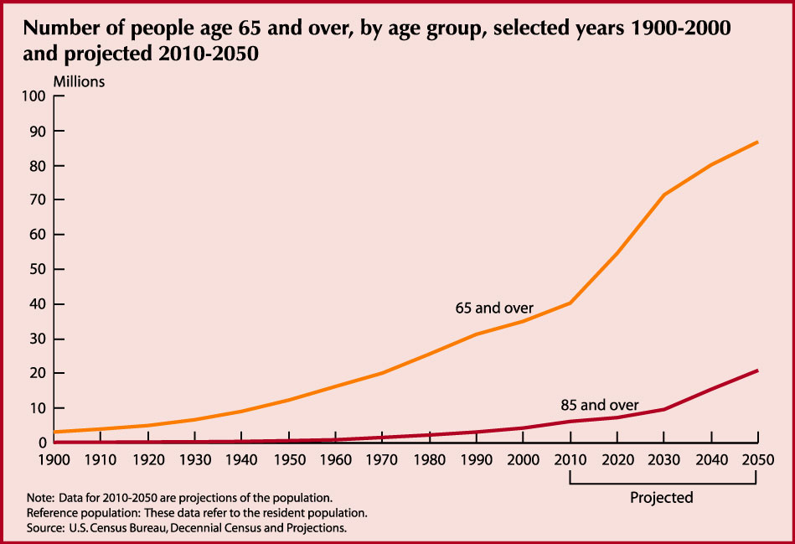

Slide 21
Why does elder abuse happen?
Greed
Ageism
Payback
Entitlement
Power and control
Resentment
Ignorance/Untrained/Undertrained
Untreated mental illness/substance abuse
Caregiver stress
Notes:
Why is elder abuse happening?
Greed – love of money is the root of all evil
Ageism—”She’s old anyway and doesn’t matter that much.” “I won’t worry about her since won’t be around that much longer.”
Payback for past treatment – “she was a terrible mother, so now it is my turn to be terrible to her”
Entitlement – “It’s going to be my money anyway; I’ll get it now rather than later”
Power and control--domestic violence model
Resentment—studies of caregivers found that those who felt burden and resentment were likelier to engage in abusive behaviors
Ignorance about care needs, care provision, resources
Mental illness--caregiver w. untreated schizophrenia, addictions
Stress– Caregiver stress is a very real phenomenon, but many caregivers handle stress without resorting to abusive tactics. We can’t say simply that caregiver stress causes abuse.

Slide 22
Understanding the triggers of abuse is important. So is accountability.
Caregivers can be very stressed by their responsibilities, but this does NOT grant them permission to behave in an abusive manner
Notes:
Caregivers can be very stressed by their responsibilities, but this does NOT grant them permission to behave in an abusive manner.
This is why we need mandatory reporters: so that people are held accountable for their actions. Once abuse or neglect is identified, then it can be reported and stopped. Once the need is made clear, service providers can help the elder or dependent adult, and his or her family.

Slide 23
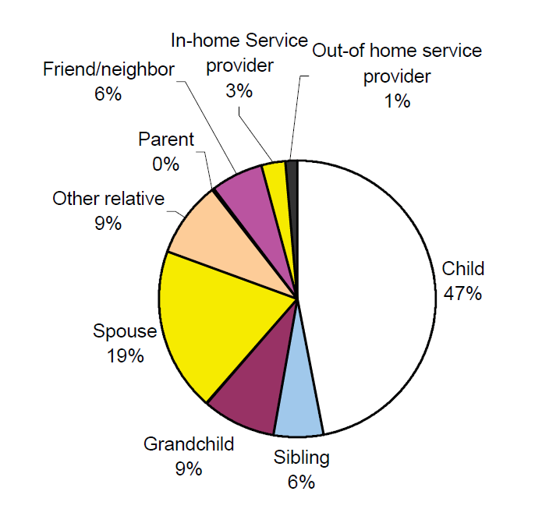
Who abuses?
FAMILY MEMBERS
In general:
  52% are men
  48% are women
  30% are themselves over 60
National Elder Abuse Incidence Study , 1998
Notes:
Majority of abusers are family members:
Nearly 50% are adult offspring
About 20% are spouses/partners
In general:
52% are men
48% are women
30% are themselves over 60
The National Elder Abuse Incidence Study , 1998, The National Center on Elder Abuse at The American Public Human Services Association* in Collaboration with Westat, Inc.

Slide 24
Abuse: Caregiver Characteristics
Depressive symptoms
Inadequately treated mental health and/or substance abuse problems
Feel stressed, burdened, and/or resentful
Notes:
24

Slide 25
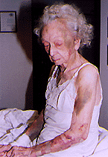
Abuse: Victim Characteristics
Over 80 years of age
Dementia
Female gender (2/3 of reports)
Verbally aggressive
Physically aggressive

Slide 26

High Risk Caregiving Situations
People with inadequately treated mental health and/or substance abuse problems are more likely to be abusive
People who feel stressed/burdened/resentful are more likely to be abusive
Providing care for an older adult who is physically combative and/or verbally abusive
Notes:
26

Slide 27

Types of Reportable Abuse
Physical/Sexual
Financial
Abduction
Abandonment
Isolation
Mental Suffering
Neglect/Self-Neglect
Notes:
The types of reportable abuse are:
Physical
Financial
Abduction
Abandonment
Isolation
Mental Suffering
Neglect/Self-Neglect
In the next few slides we will talk about definitions and examples of these different types.

Slide 28
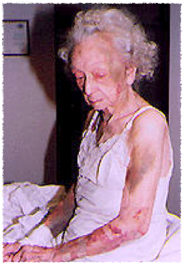
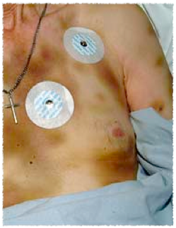
Physical/Sexual Abuse
Physical pain, injury, impairment
Inappropriate use of drugs
Inappropriate use of restraints
Sexual abuse
Unexplained venereal disease or genital infections
Genital or anal pain, itching,
bruising, or bleeding
Notes:
Physical abuse includes:
Assault/battery (such as beating, slapping, pushing, kicking) causing pain or injury
Inappropriate use of drugs—we’ll go into this in a minute.
Inappropriate use of restraints (physical and chemical)
Sexual abuse is often overlooked due to stereotypes. Red flags include unexplained STDs and genital or anal pain or injuries.

Slide 29
“Torn from the headlines…”
STATEN ISLAND ADVANCE
'Shameless' pill grabs at Staten Island nursing homes
2 nurses nabbed in pilfering of painkillers meant for their patients
Friday, November 14, 2008 By Phil Helsel
STATEN ISLAND, N.Y. -- Two longtime nurses at a pair of Staten Island nursing homes have been arrested on charges they stole [Percocet] from supplies intended for their elderly patients -- thefts that have baffled co-workers, who say the women were model employees.
Each is charged with first-degree falsifying business records, willful violation of health laws and possession of a controlled substance, which carries up to four years in prison.
Notes:
Abuse by Medications frequently involves theft or watering-down of controlled substances prescribed to the patient.

Slide 30
Physical Abuse: Medications
Medications given not Rx’ed to patient
Doses too high or too low
Intentional over/under-medicating
Timing of administration not optimum
    e.g., Withholding Pain Medicines
Unrecognized adverse effects
Inability to swallow
Confusion with medication on the part of
the caregiver
Lack of training/understanding
Notes:
Abuse by medications may take many forms:
Overuse, such as using benzodiazepenes simply to keep a patient quiet.
Underuse, such as withholding of meds that help improve a Parkinson’s patient’s mobility
Misuse (medications given are not prescribed for patient’s treatment) such as use of unprescribed psychotropics to make a patient more docile.
Other problems include failure to recognize adverse effects or patient’s inability to swallow.
Another common issue is caregiver’s lack of understanding about use and administration of meds.

Slide 31
Financial Abuse
Fear, vague answers, anxiety when asked about personal finances
Disparity between assets and appearance/general condition
Failure to purchase medicines, medical assistive devices, seek medical care or follow medical regimens
Recent new acquaintance or people moving in with victim
Notes:
Financial abuse is the illegal or improper exploitation of funds or other resources, including theft, extortion, and fraud.
Adults are free to make bad financial decisions if they have the cognitive capacity.
We’re trying to stop theft, trickery, threats, or taking advantage of a person’s diminished financial decision-making capacity.
Signs include:
Fear, vague answer, anxiety when asked about personal finances
Disparity between assets and appearance /general condition
Failure to purchase medicines, medical assistive devices, seek medical care or follow medical regimens
Recent new acquaintance or people moving in with victim

Slide 32
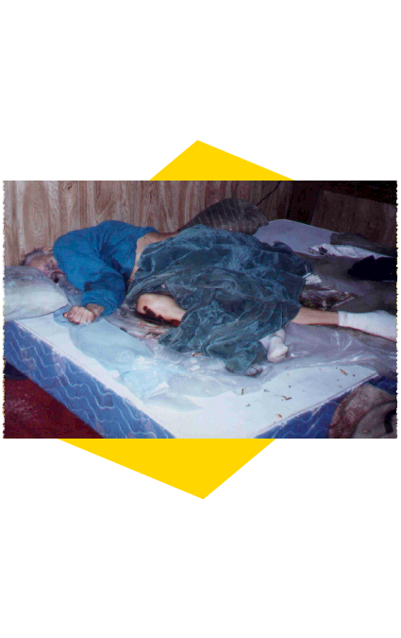
Abandonment
Desertion of a vulnerable adult by anyone who has assumed the responsibility for care or custody of that person
Abduction
Removal from this state and restraint from returning to this state when the person lacks capacity to consent to this removal.
Notes:
Abandonment—you can see that the caregiver role is a key element
Abduction—the patient’s decision-making capacity to consent to removal is very important here

Slide 33
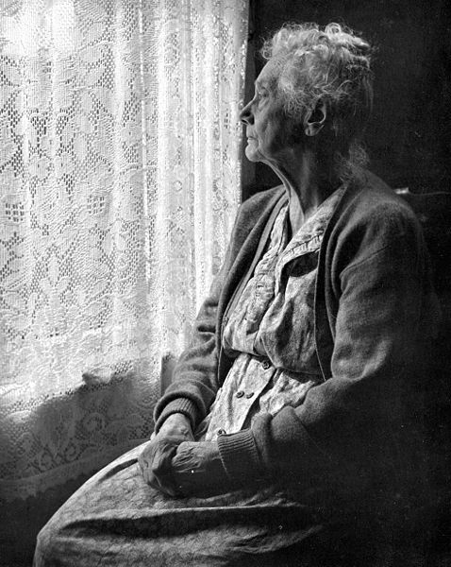
Isolation
The act of systematic exclusion of a victim from all real outside contact
S:/ 1/14/09 Mrs. K feels isolated, family members do not speak to her when she is home. Excluded from family activities, outings. Friends not allowed to visit. Pt does not participate in any outside activity.
Daughter via phone -- C/O increased difficulty to care for patient. Pt refuses PO meds and food, appears depressed
Notes:
Unlike kids, older adults can fade away from society’s view. If kids are missing from school, systems are in place to recognize and respond to this. Too often, there’s no such safety net for elders. People will assume, “Oh, I guess the old person is sick.”
Sometimes, the elder or dependent adult is too incapacitated to report the abuse they’re experiencing.
Signs of abuse are sometimes missed or mistaken for usual aging.
In some cases, a caregiver who is financially or physically abusing or neglecting the vulnerable adult will also keep away all potential witnesses of the mistreatment. They might lie to the patient and claim that no one else cares about them.

Slide 34
Mental Suffering
Intentional infliction of mental anguish/suffering by use of threat, intimidation, humiliation, or other abusive conduct
Notes:
Mental suffering, or psychological abuse, is the intentional infliction of mental anguish/suffering by use of threat, intimidation, humiliation, or other abusive conduct.
This can take the form of verbal harassment, threats, or other intimidating behavior.
Often, psychological abuse is a red flag for additional types of co-occuring abuse. For example, it’s easier to steal from someone if you dehumanize them.

Slide 35
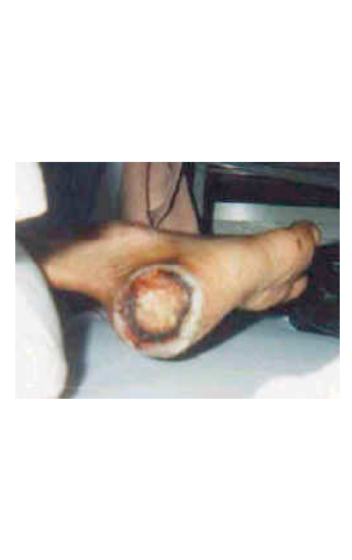
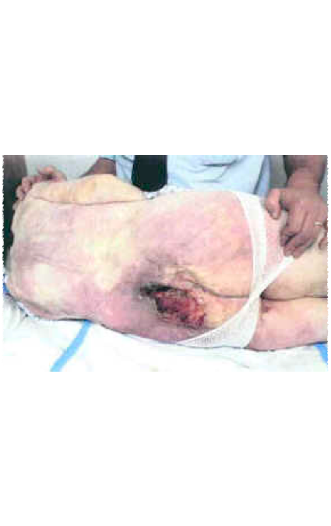
Neglect/Self-Neglect
Excessive or inadequate
clothing
Untreated “bed” sores or rashes
Absence of assistive devices
Frequently missing appointments
Absence of medications
Notes:
Neglect- failure of caregiver to provide appropriate care when the vulnerable adult is not able to provide their own basic necessities such as food, clothing, shelter, medical treatment, or personal care.
A neglected person might be forced to lie in their own feces for hours or days. She might be malnourished and dehydrated when she can’t feed herself. She might have long untended fingernails and toenails, matted hair. If she’s unable to move on her own and no one repositions her, she might get bedsores (also known as pressure ulcers) due to tissue death. In some cases, when left untreated these can go all the way down to the bone.
Signs include:
* Excessive or inadequate clothing
* Untreated “bed” sores or rashes
* Absence of assistive devices
* Frequently missing appointments
* Absence of medications

Slide 36
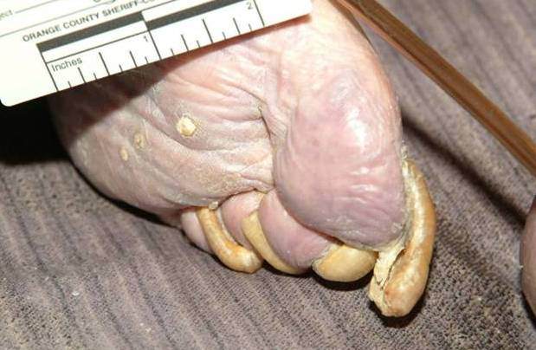
Neglect/Self-neglect
Poor hygiene
Overgrown nails
Unshaven
Decayed teeth
Odorous
Soiled clothing
Matted, unkept hair
Notes:
Here are some other signs of neglect or self-neglect.
Again, if it’s possible to get information about any care provision roles/agreements, this will help investigators to differentiate between neglect or self-neglect.

Slide 37
Effects of Abuse on Health
Increased Mortality
Abused adults are 300% more likely to die than non-abused adults
  Lachs et al. 1998, Dong et al. 2009
Poorer physical outcomes (probable)
  Anetzberger 2004; American Medical Association 1990; Lindbloom et al. 2007
    Increased pain
    Exacerbation of existing conditions
    Welts, wounds, injuries
    Increased susceptibility to infection

Slide 38
Effects of Abuse on Finances
  Restitution often not forthcoming or too late
  No time to rebuild assets
  Loss of choices for older adult; loss of independence
  Reliance on others for financial support
  Intergenerational transfer of wealth impacted
  More quickly spending down to Medicaid
Notes:
Intergenerational wealth isssues
As far back as 1990, Fortune magazine talked about "the biggest intergenerational transfer of wealth in US history," in which middle-class Americans will "for the first time, inherit significant assets en masse." By 1999, the Boston College Social Welfare Research Institute had estimated an eye-popping total: that a wealth transfer of more than $41 trillion will occur by 2052.
The reality, according to one new survey, is that when people do receive an inheritance, it's typically well under $100,000. And most people will receive no inheritance at all. But even as the pool of wealth has risen, the cost of retirement has been rising. Longer life spans, coupled with the rising cost of medical care, mean that many older Americans will use their wealth rather than pass it on to children. Instead of inheriting wealth the children wind up having to spend considerable wealth taking care of their parents,“. Last year, only 31 percent of workers between ages 45 and 54 had more than $100,000 in retirement savings, according to the Employee Benefit Research Institute in Washington. An equal number had less than $10,000 saved.

Slide 39
Lab findings in Abuse (direct and indirect)
Chemistry panel
  Malnutrition, Dehydration
  Electrolyte imbalances
  Impaired renal function (BUN, Scr)
CBC w/diff
  Malnutrition
  Anemia
Medication levels
Notes:
Lab findings may be helpful in determining whether or not abuse occurred. Here’s a quick listing of the most common types of lab tests used in this context. Note that lab findings can indicate overuse OR underuse of medications.

Slide 40
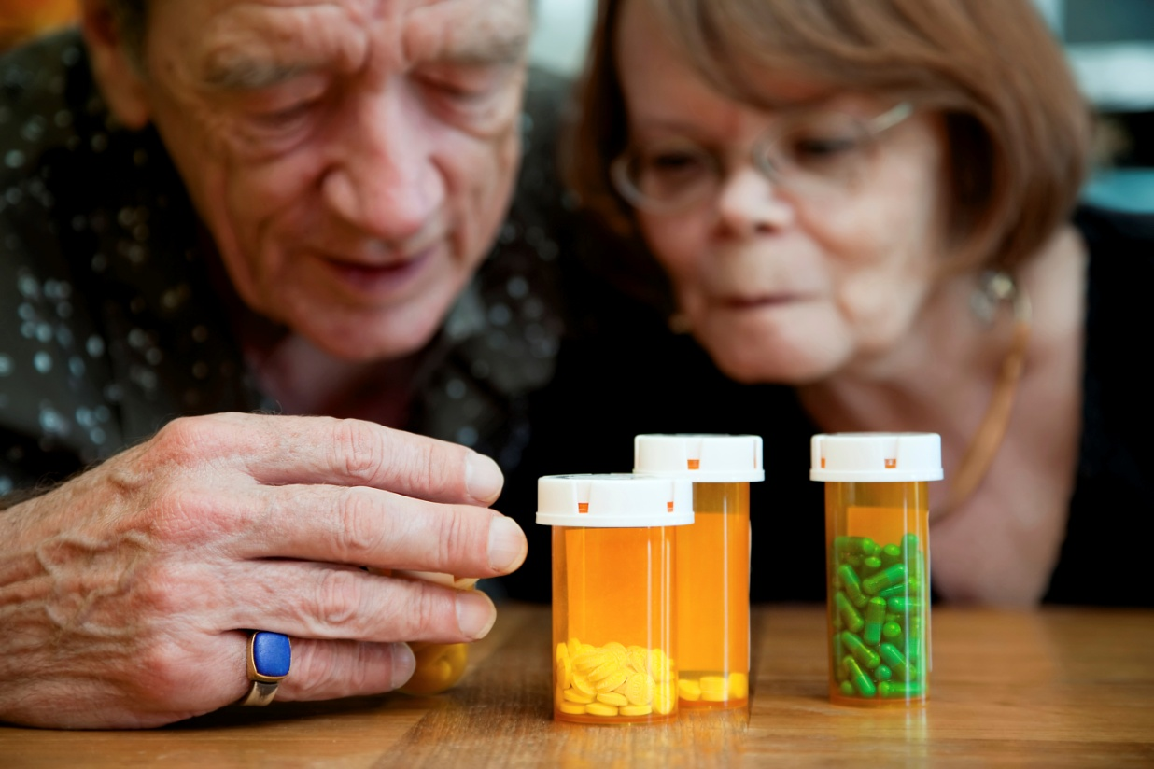
Opportunities for Pharmacists to Identify Potential Abuse
Caregiver comes to pharmacy to pick up refills
Caregiver or elder selects which to pick up and which to leave behind
Conversation with caregiver or elder takes place and information or clues about abuse are gathered
Notes:
Here’s a sample scenario. Please read these three bullet points.
Why might this raise concern?
{Facilitate a brief discussion. Answers should include:
Might not be addressing patient’s healthcare needs
Might be putting patient’s well-being at risk
How are they selecting the refills that they buy? Cost? Medical need? Value for recreational use?}

Slide 41

Opportunities for Pharmacists to Identify Potential Abuse
While doing a routine review of a patient profile, you notice the following:
  Certain medications are refilled exactly on time (e.g., narcotics)
  Others haven’t been refilled for months
  Need to contract MD/Pt
Notes:
Here’s a slightly different scenario.
Why might this raise concern?
{Facilitate a brief discussion. Answers should include:
Might not be addressing patient’s healthcare needs
Might be putting patient’s well-being at risk
Is the patient’s pain being treated or are the meds obtained for sale or recreational use?}

Slide 42
Video Scenario One
“I’m here to pick up for Jane Appleby”--Mrs. Appleby (Training Pharmacists about Elder Abuse)
http://www.youtube.com/watch?v=nmb9vKsvNys
Notes:
{Instructor Notes: Test these links in advance to ensure that they will play smoothly on your computer. It might enhance the flow if you already have these open in your browser and minimized until you are ready to show them.
Review the discussion questions in advance; it might be helpful to refresh your memory about related cases you’ve experienced, and your organization’s procedures and resources for responding.
For written descriptions of these and other scenarios, visit www.centeronelderabuse.org/Kaiser_Pharmacy.asp}
“I’m here to pick up for Jane Appleby”--Mrs. Appleby (Training Pharmacists about Elder Abuse)
http://www.youtube.com/watch?v=nmb9vKsvNys

Slide 43
Discuss Scenario One
Was elder abuse present?
If so, what kinds?
What signs did you see?
What action, if any, should the pharmacist take now?
Notes:
Was elder abuse present? Yes
If so, what kinds?
Financial abuse (caregiver is using the elder’s money for her own benefit)
Neglect (caregiver leaves behind medicines that the elder needs)
Emotional abuse (caregiver is rude to the elder, doesn’t listen to her and calls her “slow”)
Abuse by undermedication, indicated by the aide’s failure to obtain the needed blood pressure meds, might qualify as both physical abuse and neglect.
The aide’s rough treatment is suspicious for physical abuse.
Supplemental question: Suppose you saw bruises on the older woman’s arms. What characteristics of the bruises would you note? What else would you like to know? (Size, shape, location, how many, ask the patient and caregiver about them and assess their responses, presence and characteristics of other injuries.)
Based on these observations, the pharmacist could call Adult Protective Services to report suspected financial abuse and neglect of the elder.
Emotional abuse is not a mandated report in the state of California, but it certainly can be mentioned to APS
If another caregiver (e.g., family member, Home Healthcare Agency supervisor) is known to the pharmacist, he might call to share his concerns.

Slide 44
Video Scenario Two
"I have a prescription to pick up" --Mr. Stepania (Training Pharmacists about Elder Abuse) http://www.youtube.com/watch?v=ua0VhxRE3Nk
Notes:
"I have a prescription to pick up" --Mr. Stepania (Training Pharmacists about Elder Abuse) http://www.youtube.com/watch?v=ua0VhxRE3Nk
{For written descriptions of these and other scenarios, visit www.centeronelderabuse.org/Kaiser_Pharmacy.asp}

Slide 45
Discuss
Was elder abuse present?
If so, what kinds?
What signs did you see?
What action, if any, should the pharmacist take now?
Notes:
Was elder abuse present? Yes
If so, what kinds?
At this point it’s not clear whether it’s neglect or self-neglect. We don’t know yet if the son has assumed a caregiver role. We don’t know if the patient usually has capacity for self-care and had a recent change. Either neglect or self-neglect would be a reasonable conclusion.
It’s okay to make a report even if you’re not completely sure which kind of abuse/neglect it is.
Based on these observations, the pharmacist could call Adult Protective Services to report suspected self-neglect or neglect.
However, if the pharmacist has the patient’s permission to call his son, the pharmacist can also talk to the son and explain that his father needs help managing his medications and the consequences if that help is not forthcoming. Self-neglect/neglect by others is a mandated report in California.
The pharmacist could call the patient’s physician to share his concerns.
Supplemental question: Have you ever been in a situation where you felt it wasn’t safe to let a patient try to get home on their own?

Slide 46
Video Scenario Three
"I'd like to pick up a prescription for my father"--Mr. Jones (Training Pharmacists about Elder Abuse)
http://www.youtube.com/watch?v=qlMbn6QzNb4
Notes:
"I'd like to pick up a Rx for my father"--Mr. Jones (Training Pharmacists about Elder Abuse)
http://www.youtube.com/watch?v=qlMbn6QzNb4
Note: Could also be a clinical pharmacist talking with patient at clinic.
*Update: Darvocet is no longer being produced due to its lack of efficacy, so for training purposes you can replace any mention of Darvocet with a more appropriate example such as Vicodin.
{For written descriptions of these and other scenarios, visit www.centeronelderabuse.org/Kaiser_Pharmacy.asp}

Slide 47
Discuss
Was elder abuse present?
If so, what kinds?
What signs did you see?
What action, if any, should the pharmacist take now?
Notes:
Was elder abuse present? Yes, or enough to suspect mistreatment
If so, what kinds?
Financial abuse (caregiver is using or selling something that belongs to the elder)
Neglect (caregiver is not giving the elder medications which he needs for pain)
When controlled substances are being used, be on the lookout for substance abuse by the patient, the patient’s caregiver, or both.
Based on these observations, the pharmacist could call Adult Protective Services to report suspected financial abuse and neglect of the elder.
Remember: it is not your job to substantiate the abuse; it is your job to detect and report it.
Supplemental questions: What additional information would you want to know?
(E.g., is the father’s money being used to pay for the Darvocet? How is the Darvocet being used? Is the patient’s pain adequately treated?)
How could you get more information?
(Call the patient’s physician and express concerns about (a) the use of Darvocet and (b) undertreated pain)

Slide 48
How to Report Abuse
In the community:
Adult Protective Services
  Social workers/nurses
  Receive reports of abuse from mandated reporters and others
  Work with elder/dependent adult to help them access resources in community to stay safe
  In many states: Cross report to police
In residential facilities:
Long-term Care Ombudsman
  Social workers/volunteers
  Receive complaints from residents
  Advocate on behalf of residents
  Work with State Licensing to identify problems in facilities

Slide 49

Adult Protective Services
Receive reports of suspected elder/dependent adult abuse 24- hour, 7 days a week
Live person response
Contact immediately by phone and follow up with required form
Notes:
The main reporting agency is Adult Protective Services. Social services workers from APS investigate all at-risk situations involving elderly and dependent adults living in the community.
APS has a 24-Hr Reporting Hotline in each jurisdiction in California.
Each county has its own APS reporting line. The information is available online (http://www.cdss.ca.gov/agedblinddisabled/PG1298.htm) or anywhere in California you can call the Aging Info & Referral Line at 1-800-510-2020 to reach your local APS office.
County APS agencies investigate reports of abuse of elders and dependent adults who live in private homes and hotels or hospitals and health clinics when the abuser is not at staff member. (The Licensing & Certification program of the California Department of Health Services handles cases of abuse by a member of a hospital or health clinic.) County APS staff evaluates abuse cases and arranges for services such as advocacy, counseling, money management, out-of-home placement, or conservatorship.
Reports of abuse that occur in a nursing home, a board and care home, a residential facility for the elderly, or at a long term care facility are the responsibility of the Ombudsman's office which is administered by the California Department of Aging.
APS staff also provides information and referral to other agencies and educates the public about reporting requirements and responsibilities under the Elder and Dependent Adult Abuse Reporting laws.

Slide 50
Reports should include:
Name of Reporter
Name and age of victim
Present location of victim
Names and addresses of family members or any other person responsible for the victim’s care, if known
Date of the incident
ANY other information, including information that led the Reporter to suspect abuse, requested by the agency receiving the referral
Notes:
These are the kinds of information needed for your report. As you can see, this is very basic information.
The Report of Suspected Elder or Dependent Adult Abuse is a one-page form which shows all the kinds of information needed. It is available on Resources page from centeronelderabuse.org

Slide 51
What to include in your report
The best information includes descriptions of things you
  Saw
  Heard
  Smelled
  Felt (temperature, moisture)
  Were told

Slide 52
Abuse suspected
1. Make verbal report by phone as soon as possible to Adult Protective Services. In Orange County, call (800)-451-5155
2. Download California and complete state form SOC 341 from www.centeronelderabuse.org click “Resources”
3. Further instructions given by APS.
4. DOCUMENT suspected abuse in chart notes, computerized system
Confidentiality: Reporting party is not disclosed to victim, their family, or the alleged abuser
Notes:
{Instructor: to find reporting agency contact information for your area, visit http://www.cdss.ca.gov/agedblinddisabled/PG2300.htm}
When abuse is suspected, report it.
Abuse does NOT need to be confirmed
Telephone when practically possible
Complete the formal written report [in California: SOC 341], mail or fax within 2 working days
Your confidentiality is protected. The reporting party’s identity is not disclosed to the victim, their family, or to the alleged abuser.

Slide 53

Adult Protective Services: Investigation
APS responds immediately or within 10 calendar days.
APS Social worker makes contact with the possible victim, suspected abuser to determine:
  Type of abuse
  Duration/frequency of abuse
  Identity of suspected abuser
  Will abuse continue if intervention is not made?
Notes:
Based on the information you report, Adult Protective Services staff will determine how quickly to respond.
The APS Social Worker will make contact with the potential victim, alleged abuser, and others in order to assess the situation.

Slide 54

APS gathers information
Victim’s strengths and limitations
Victim’s medical conditions, medications involved, providers being seen
Gather statements from health care providers
Notes:
APS will gather information about the alleged victim’s physical and cognitive condition and vulnerabilities. When requested as part of an abuse investigation, relevant patient information can be shared by health care providers with no fear of HIPAA.

Slide 55
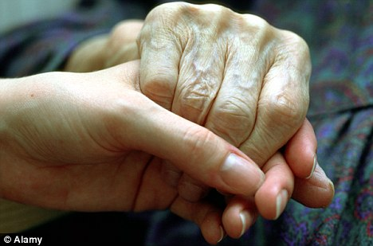
Adult Protective Services
  Involves assistance of emergency personnel (Law enforcement or paramedics) in life threatening situations
  Can arrange for available temporary emergency shelter for patient in abusive environment
  May provide counseling and information and referral service
  Advocates on behalf of the patient in situations where s/he cannot act effectively on his/her own behalf
Notes:
APS workers are trained to respond quickly if the alleged victim is in an emergency situation.
APS workers will try to determine what resources are needed by the alleged victim and family and provide information and referrals.

Slide 56
APS Limitations
APS services are voluntary and can only be provided with the patient’s consent
Cannot force someone into placement despite need
Results of report are confidential. Reporter does not know results of APS’s intervention
Notes:
Unless there’s an immediate threat of bodily harm or the elder or dependent adult lacks the capacity to decide, APS can’t provide help without the client’s consent.
Unlike Child Protective Services, APS can’t remove a client from her situation against her will.
Information that APS can share is restricted. They can’t disclose the identity of the person who made the report. They also can’t tell you the result of their investigation unless they need to on behalf of the client’s well-being.

Slide 57
Myth or Fact?
1) Elder abuse is not a problem in my community.
2) It’s a family issue and I shouldn’t get involved.
3) If I report suspected abuse, Adult Protective Services will remove the older adult from their home
Notes:
{Facilitate a discussion about these claims. Why do people often hold these beliefs?}

Slide 58
Myth or Fact?
Elder abuse is not a problem in my
community.
It’s a family issue and I shouldn’t get
involved.
If I report suspected abuse, Adult Protective
Services will remove the older adult from their home
These are all MYTHS
Notes:
All of these are MYTHS or misconceptions.
MYTH 1: Elder abuse is not a problem in my community.
Elder abuse affects people from all socio-economic groups, cultures, and ethnicities. Studies show that between 2 and 10% of the nation’s older adult population experiences abuse, neglect, exploitation or self-neglect each year. The few studies comparing different cultural groups’ perceptions of elder abuse found significant variations between groups in the identification and perceived seriousness of psychological, physical, and financial elder abuse and neglect. It’s important to consider how people define elder abuse, and how cultural norms may affect willingness to report or cooperate with interventions.
MYTH 2: It’s a family issue and I shouldn’t get involved.
Families are often ill-equipped to identify and address elder abuse, so it’s critical for community members to notice and help elders at risk for mistreatment. For every case of suspected elder abuse that is reported to authorities, five cases go unreported. Many older victims’ needs are not being addressed by health, legal, and social services systems. While the effectiveness of interventions needs to be thoroughly studied, systems won’t even have a chance to help unless mistreatment is reported.
MYTH 3: If I report suspected abuse, Adult Protective Services will remove the older adult from their home.
If there is no serious threat of immediate harm, Adult Protective Services workers will not remove a non-consenting adult from their residence. Unlike when child abuse is suspected, in elder/adult abuse cases the social worker presumes the client has decision-making capacity. Unless a court adjudicates otherwise, they must accept the client’s choices.
Guiding Value: Every action taken by Adult Protective Services must balance the duty to protect the safety of the vulnerable adult with the adult’s right to self-determination.
—National Adult Protective Services Association. Code of Ethics

Slide 59
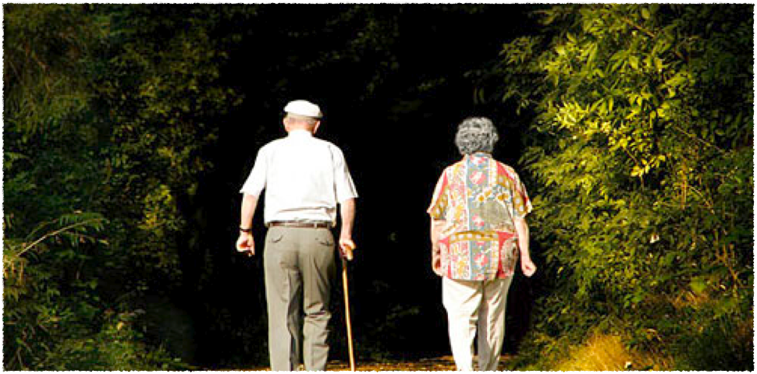
Questions?
Notes:
{Be prepared for students to share cases they have heard about.
Be ready to give examples of policies and procedures around elder abuse and neglect reporting in clinics, community pharmacies, nursing facilities, etc.
You might also want to reiterate the local reporting agencies and go over a sample reporting form.}

Slide 60
Post-test Questions
Elder abuse is caused by:
  Caregiver stress
  Power & control
  Greed
  Ageism
  All of the above
2) Dementia increases the chance of someone becoming a victim of elder abuse. True or False?
3) To report elder abuse taking place in the community, a pharmacist must report it to _________

Slide 61
Post-test questions
4) Pharmacists may see signs of elder abuse when
a) consulting with an elderly patient at the pharmacy counter
b) doing a routine review of a patient’s file
c) talking with a caregiver
d) observing a caregiver and a dependent adult together in the pharmacy
e) all of the above

Slide 62
Post-test questions
5) Adult Protective Services workers have the same powers as Child Protective Services workers. True or False?
6) Most perpetrators of elder abuse are:
a) related to the victim
b) men
c) older than the victim
d) itinerant workers

Slide 63
Unless otherwise noted, all images are property of UC Irvine Program in Geriatrics, or obtained from Microsoft Clip Art.

